Slide 1
AdventureWorks Sales Insight- Maven Analytics Project

Slide 2

TABLE OF CONTENTS
01
02
03
04
OBJECTIVES
KEY PERFORMANCE INDICATORS
DATA MODEL
KEY INSIGTS & TAKEAWAYS

Slide 3


01
OBJECTIVES OF THE PROJECT

Slide 4
PROJECT DETAILS
THE SITUATION
You’ve just been hired as a Business Intelligence Analyst by
AdventureWorks*, a global manufacturing company that produces cycling equipment and accessories
THE GOAL
The management team needs a way to track KPIs (sales, revenue, profit, returns), compare regional performance, analyze product level trends, and identify high-value customers. All you’ve been given is a folder of raw csv files, which contain information about transactions, returns, products, customers, and sales territories.
OBJECTIVE
Use Power BI Desktop to:
• Connect and transform the raw data
• Build a relational data model
• Create calculated columns and measures with DAX
• Design an interactive dashboard to visualize the data

Slide 5

02
KEY PERFORMANCE INDICATORS

Slide 6
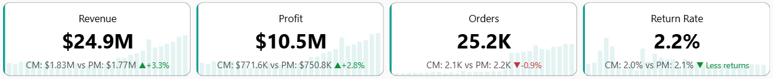
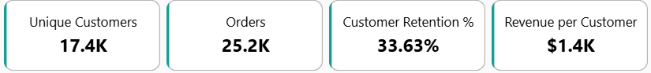
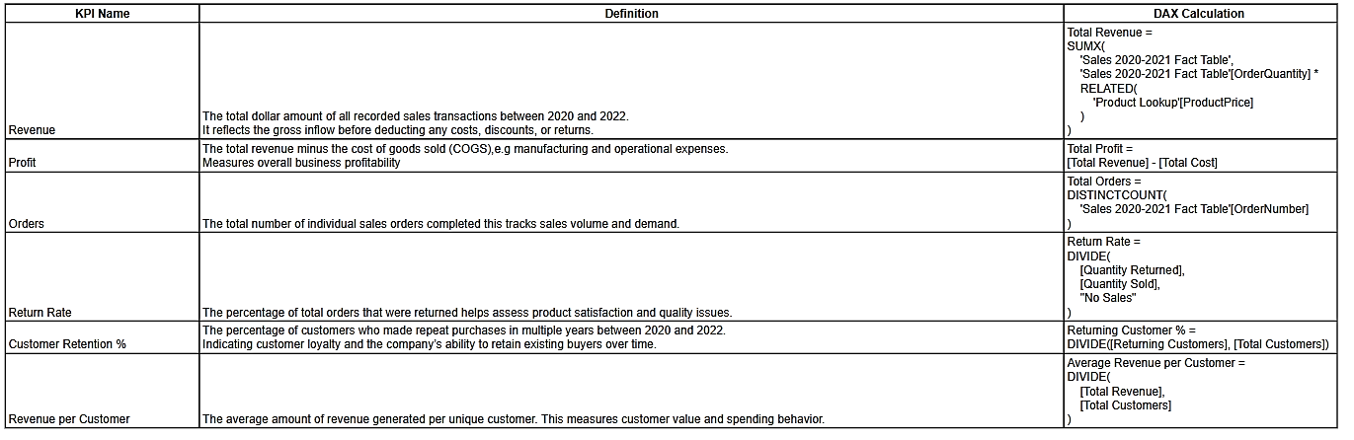
KPI’S USED & DEFINITION

Slide 7
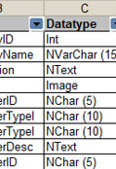
03
DATA MODEL

Slide 8
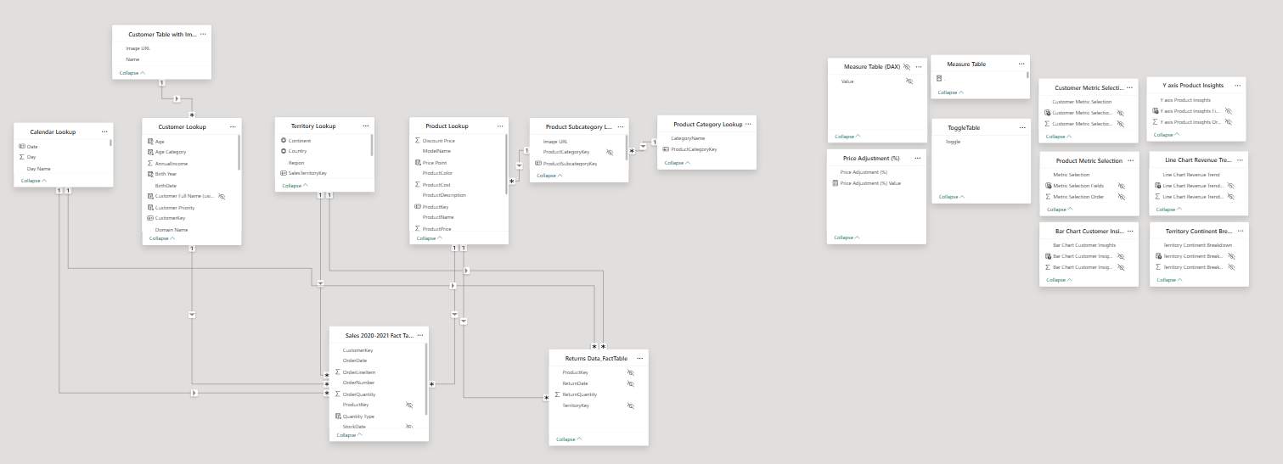
DATA MODEL & DEFINITION
TABLES
Calendar Table: This was used to ensure consistent time intelligence across all visuals
Sales 2020-2021 Fact Table: This table contains information about sales orders, order dates, it was used to create visuals and measures
Product Category Lookup: This table contains information about the categories and ID’s
Customer Lookup: This table contains customer info such as names, income, education level etc.
Product Lookup: This table contains information about products, descriptions and prices
Product Subcategory Lookup: This table contains the product subcategories along with the ID’s
Returns Data_FactTable: This table contains information about return orders, including return dates it was used to create visuals and measures
Territory Lookup: This table contains information about sales territories and geographic locations
Measure Table: ​This table stored all custom DAX measures used in the report
Field Parameter Tables: Custom tables created using Power BI’s field parameter feature that switches between different fields or measures in visuals.

Slide 9

04
KEY INSIGHTS & TAKEAWAYS

Slide 10
KEY INSIGHTS

Slide 11
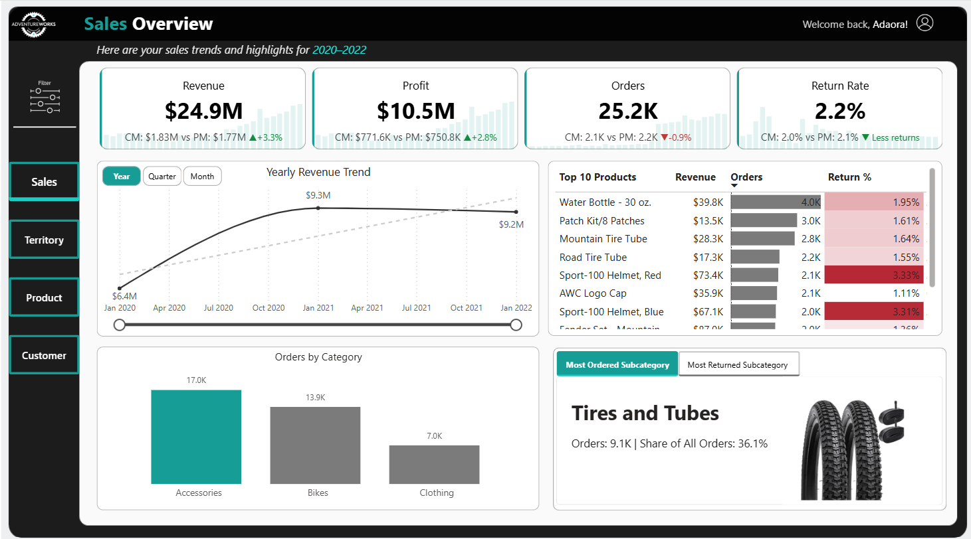
SALES OVERVIEW
Summary (2020–2022)
Sales peaked in 2021 with $9.3M revenue and stabilized in 2022, orders grew steadily while return rates declined from 3.3% to 2.1%, showing improved fulfillment or satisfaction. Seasonal spikes were observed in late 2021, likely driven by demand surges or promotions. Accessories led in volume, bikes in revenue, and clothing gained traction in 2022. Top products included Water Bottle – 30 oz. (most ordered) and Sport-100 Helmet (high revenue, high returns). While at the subcategory level, Tires and Tubes contributed over a third of total orders (36.1% or 9.1K)
Click to view full Sales Analysis

Slide 12
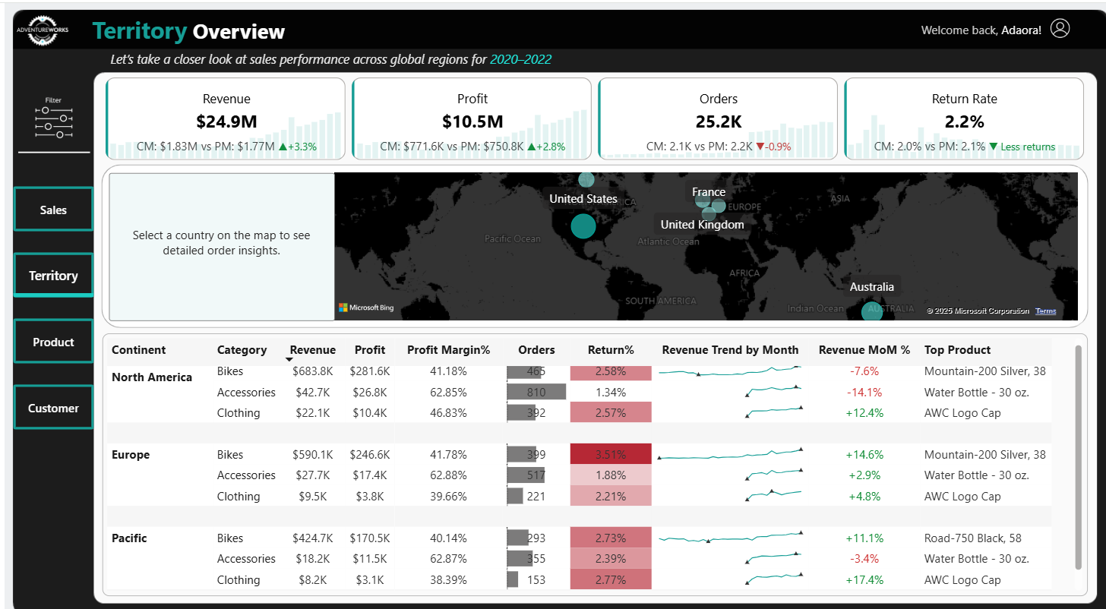
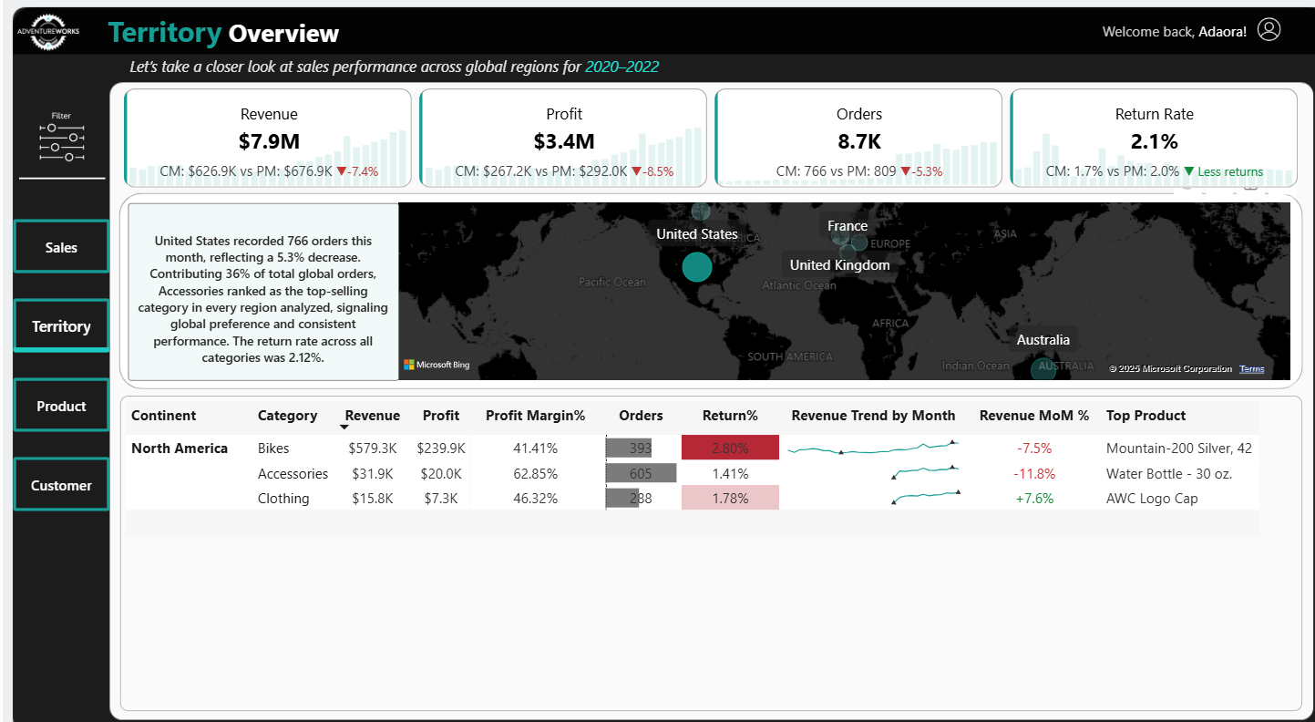
TERRITORY OVERVIEW
Summary (2020–2022)
North America led in both revenue and order volume, contributing over a third of global sales. Accessories emerged as the top-selling and most profitable category globally, reflecting consistent demand and customer preference. Europe had strong growth momentum (+13.9% MoM), but high bike return rates. The Pacific region was the smallest but fastest-growing region, with standout performance in Clothing (17.4%), suggesting untapped market potential. Across all regions, AWC Logo Cap and the 30 oz. Water Bottle consistently ranked as top-performing products. The United States stood out with the highest number of orders among all countries, contributing 36% of global order volume
Click to view full Regional Analysis

Slide 13
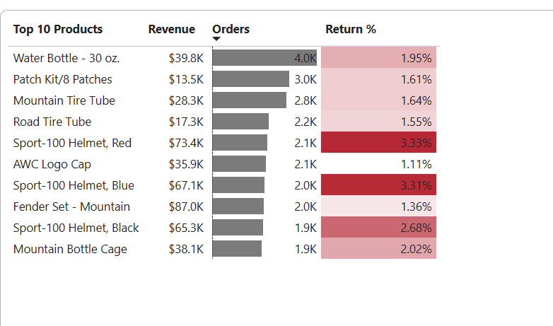
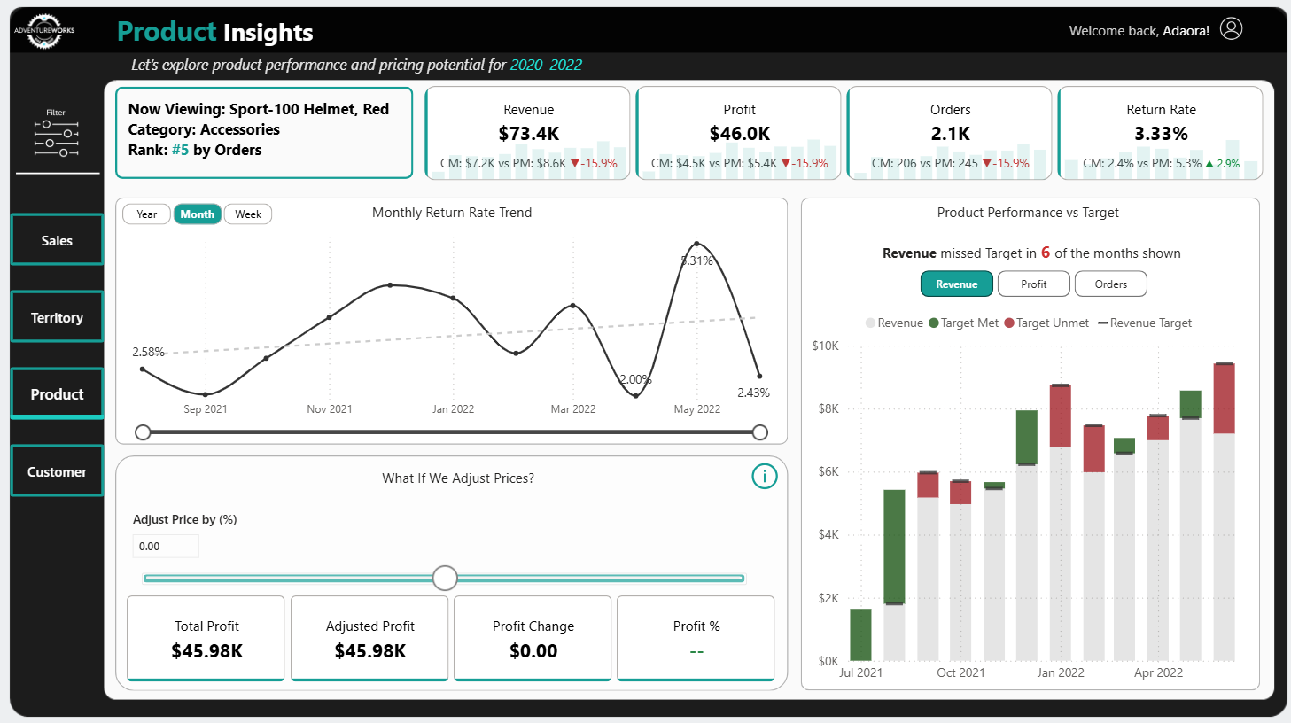
PRODUCT OVERVIEW
Summary (2020–2022)
The Sport-100 Helmet, Red was the highest return rate product at 3.33% but still ranked top 5 in orders, generating $73.4K in revenue and $46K in profit. Monthly return spikes aligned with high sales periods, implying volume drove returns not dissatisfaction. North America led in performance but saw volatility, the Europe region missed targets the most while the Pacific had the highest return rate. The price adjustment tool can be used to inform strategic pricing without sacrificing volume.
Click to view full Product Insight

Slide 14
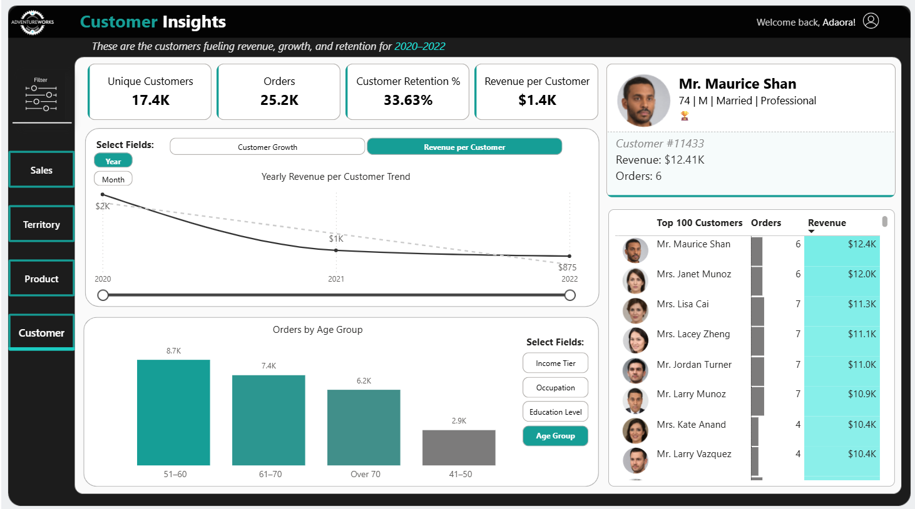
CUSTOMER OVERVIEW
Summary (2020–2022)
AdventureWorks served over 17.4K customers from 2020 to 2022, generating 25.2K orders with a 33.6% retention rate and an average revenue per customer of $1.4K. While customer count rose sharply from 3K to 11K, individual spending dropped from $2K to $875, highlighting a shift toward volume over value. Most orders came from average and low-income tiers, professionals and skilled workers, and customers aged 51–70. Undergraduates made up most of the order volume, and females and singles slightly outspent their counterparts. Top customers like Mr. Maurice Shan and Mrs. Janet Munoz each spent over $10K, revealing opportunities to nurture similar high-value profiles.
Click to view full Customer Analysis

Slide 15
TAKEAWAYS

Slide 16
Customer acquisition efforts are succeeding but at the cost of profitability per customer. The customer base nearly quadrupled from 3K to 11K, but revenue per customer dropped by 56% (from $2K to $875). This signals a shift to volume driven growth that may not be sustainable without improving customer value or targeting higher spending segments.
High volume products drive success but also carry return risks. Best-selling items like the Sport-100 Helmet generated strong revenue but also had the highest return rates. Product level performance should be analyzed further to reduce return-related losses.
North America remains the strongest market, but future growth may come from the Pacific. While North America leads in orders and revenue, the Pacific region showed the fastest MoM growth and emerging demand for clothing suggesting investment potential in product expansion and marketing in underpenetrated regions.
Targeted customer segmentation could unlock additional revenue. Most purchases came from average and low-income customers aged 51–70, with undergraduates and professionals dominating. High-income tiers and younger segments are underrepresented highlighting a missed opportunity for product repositioning or bundling strategies.
Operational improvements are driving better customer experience. Return rates declined from 3.3% to 2.1% despite order growth a sign of improved fulfillment processes or satisfaction levels that should be maintained and scaled.

Slide 17
RECOMMENDATIONS & NEXT STEPS
Enhance Customer Value: By developing customer retention programs e.g., loyalty programs, cross-sell strategies, or premium tiers to increase revenue per customer.
Investigate High Return Products: A deeper dive needs to be done into return drivers (e.g., sizing, quality, expectations) for best-sellers like the Sport-100 Helmet to reduce any avoidable losses.
Invest in Pacific Region Expansion: Pilot targeted apparel campaigns and localized promotions to capitalize on fast-growing demand, especially in underpenetrated markets like Australia.
Engage Untapped Segments: Campaigns tailored to high-income and younger demographics can be utilized through product bundling, influencer partnerships, and rebranding offers to boost engagement and conversion.

Slide 18
THANKS!
Feel free to reach out if you have any questions?
adanwogbo@gmail.com

